Slide 1

332:479 Concepts in VLSI
Design
Lecture 15
SPICE Simulation
David Harris
Harvey Mudd College
Spring 2004

Slide 2
Outline
Introduction to SPICE
DC Analysis
Transient Analysis
Subcircuits
Optimization
Power Measurement
Logical Effort Characterization
Summary
Material from: CMOS VLSI Design,
by Weste and Harris, Addison-Wesley, 2005

Slide 3
Introduction to SPICE
Simulation Program with Integrated Circuit Emphasis
  Developed in 1970’s at Berkeley
  Many commercial versions are available
  HSPICE is a robust industry standard
    Has many enhancements that we will use
Written in FORTRAN for punch-card machines
  Circuits elements are called cards
  Complete description is called a SPICE deck

Slide 4
Writing Spice Decks
Writing a SPICE deck is like writing a good program
  Plan: sketch schematic on paper or in editor
    Modify existing decks whenever possible
  Code: strive for clarity
    Start with name, email, date, purpose
    Generously comment
  Test:
    Predict what results should be
    Compare with actual
    Garbage In, Garbage Out!

Slide 5
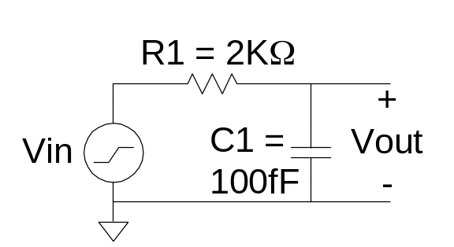
Example: RC Circuit
* rc.sp
* David_Harris@hmc.edu 2/2/03
* Find the response of RC circuit to rising input
*------------------------------------------------
* Parameters and models
*------------------------------------------------
.option post
*------------------------------------------------
* Simulation netlist
*------------------------------------------------
Vin in gnd pwl 0ps 0 100ps 0 150ps 1.8 800ps 1.8
R1 in out 2k
C1 out gnd 100f
*------------------------------------------------
* Stimulus
*------------------------------------------------
.tran 20ps 800ps
.plot v(in) v(out)
.end

Slide 6
Result (Textual)
legend:
a: v(in)
b: v(out)
time v(in)
(ab ) 0. 500.0000m 1.0000 1.5000 2.0000
+ + + + +
0. 0. -2------+------+------+------+------+------+------+------+-
20.0000p 0. 2 + + + + + + + +
40.0000p 0. 2 + + + + + + + +
60.0000p 0. 2 + + + + + + + +
80.0000p 0. 2 + + + + + + + +
100.0000p 0. 2 + + + + + + + +
120.0000p 720.000m +b + + a+ + + + + +
140.0000p 1.440 + b + + + + + a + + +
160.0000p 1.800 + +b + + + + + +a +
180.0000p 1.800 + + b + + + + + +a +
200.0000p 1.800 -+------+------+b-----+------+------+------+------+a-----+-
220.0000p 1.800 + + + b + + + + +a +
240.0000p 1.800 + + + +b + + + +a +
260.0000p 1.800 + + + + b + + + +a +
280.0000p 1.800 + + + + b+ + + +a +
300.0000p 1.800 + + + + +b + + +a +
320.0000p 1.800 + + + + + b + + +a +
340.0000p 1.800 + + + + + b + + +a +
360.0000p 1.800 + + + + + b + +a +
380.0000p 1.800 + + + + + +b + +a +
400.0000p 1.800 -+------+------+------+------+------+--b---+------+a-----+-
420.0000p 1.800 + + + + + + b + +a +
440.0000p 1.800 + + + + + + b + +a +
460.0000p 1.800 + + + + + + b+ +a +
480.0000p 1.800 + + + + + + b +a +
500.0000p 1.800 + + + + + + +b +a +
520.0000p 1.800 + + + + + + +b +a +
540.0000p 1.800 + + + + + + + b +a +
560.0000p 1.800 + + + + + + + b +a +
580.0000p 1.800 + + + + + + + b +a +
600.0000p 1.800 -+------+------+------+------+------+------+---b--+a-----+-
620.0000p 1.800 + + + + + + + b +a +
640.0000p 1.800 + + + + + + + b +a +
660.0000p 1.800 + + + + + + + b +a +
680.0000p 1.800 + + + + + + + b +a +
700.0000p 1.800 + + + + + + + b+a +
720.0000p 1.800 + + + + + + + b+a +
740.0000p 1.800 + + + + + + + b+a +
760.0000p 1.800 + + + + + + + b+a +
780.0000p 1.800 + + + + + + + ba +
800.0000p 1.800 -+------+------+------+------+------+------+------ba-----+-
+ + + + +

Slide 7
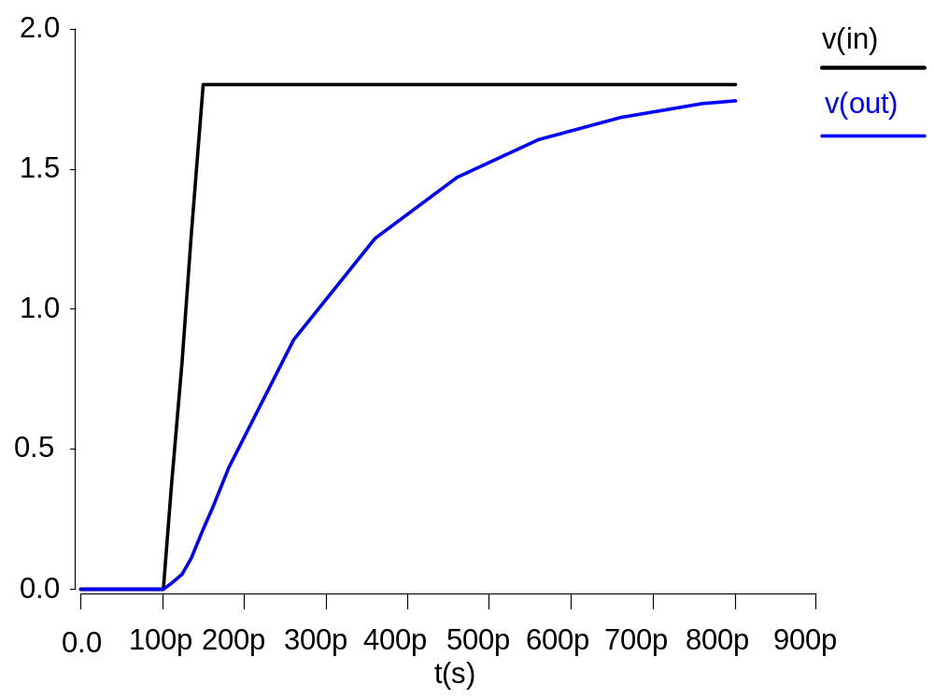
Result (Graphical)

Slide 8
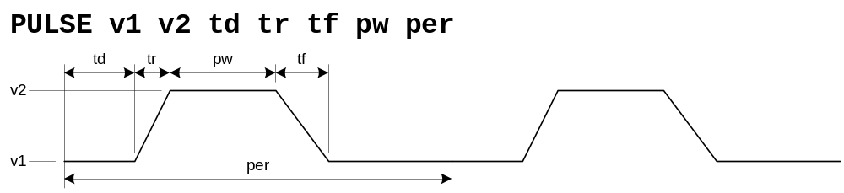
Sources
DC Source
  Vdd vdd gnd 2.5
Piecewise Linear Source
  Vin in gnd pwl 0ps 0 100ps 0 150ps 1.8 800ps 1.8
Pulsed Source
  Vck clk gnd PULSE 0 1.8 0ps 100ps 100ps 300ps 800ps

Slide 9
SPICE Elements
Letter
Element
R
Resistor
C
Capacitor
L
Inductor
K
Mutual Inductor
V
Independent voltage source
I
Independent current source
M
MOSFET
D
Diode
Q
Bipolar transistor
W
Lossy transmission line
X
Subcircuit
E
Voltage-controlled voltage source
G
Voltage-controlled current source
H
Current-controlled voltage source
F
Current-controlled current source

Slide 10
Units
Letter | Unit | Magnitude
a | atto | 10⁻¹⁸
f | fempto | 10⁻¹⁵
p | pico | 10⁻¹²
n | nano | 10⁻⁹
u | micro | 10⁻⁶
m | mili | 10⁻³
k | kilo | 10³
x | mega | 10⁶
g | giga | 10⁹
Ex: 100 femptofarad capacitor = 100fF, 100f, 100e-15

Slide 11
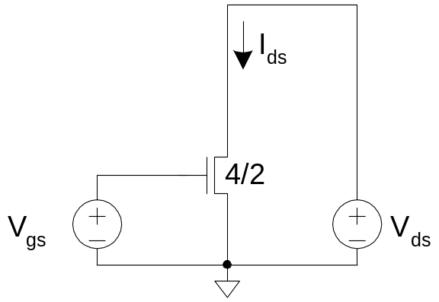
DC Analysis
* mosiv.sp
*------------------------------------------------
* Parameters and models
*------------------------------------------------
.include '../models/tsmc180/models.sp'
.temp 70
.option post
*------------------------------------------------
* Simulation netlist
*------------------------------------------------
*nmos
Vgs g gnd 0
Vds d gnd 0
M1 d g gnd gnd NMOS W=0.36u L=0.18u
*------------------------------------------------
* Stimulus
*------------------------------------------------
.dc Vds 0 1.8 0.05 SWEEP Vgs 0 1.8 0.3
.end

Slide 12
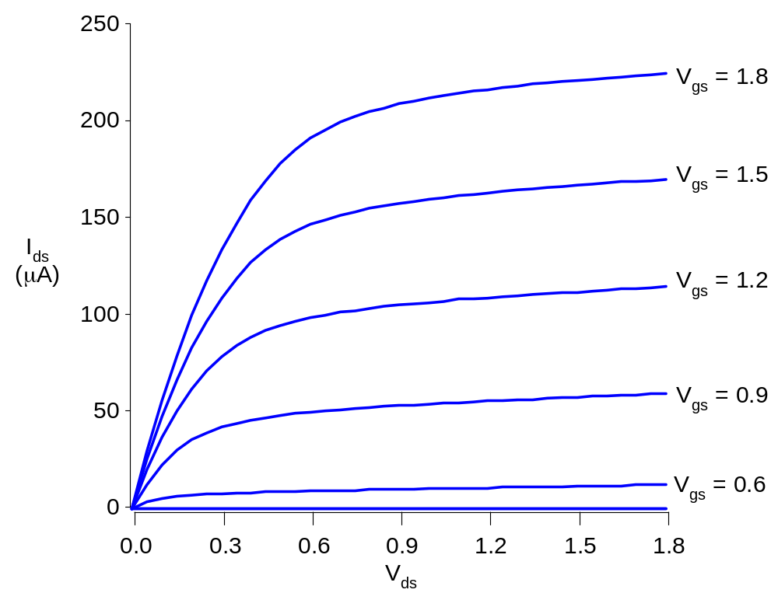
I-V Characteristics
nMOS I-V
  V_{gs} dependence
  Saturation

Slide 13
MOSFET Elements
M element for MOSFET
Mname drain gate source body type
+ W=<width> L=<length>
+ AS=<area source> AD = <area drain>
+ PS=<perimeter source> PD=<perimeter drain>

Slide 14
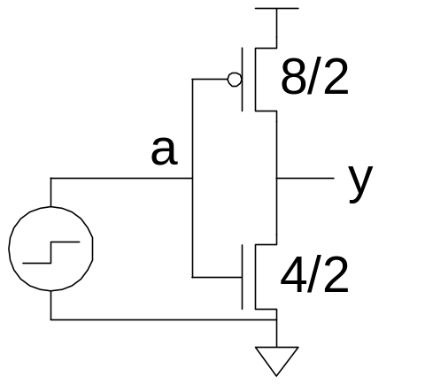
Transient Analysis
* inv.sp
* Parameters and models
*------------------------------------------------
.param SUPPLY=1.8
.option scale=90n
.include '../models/tsmc180/models.sp'
.temp 70
.option post
* Simulation netlist
*------------------------------------------------
Vdd vdd gnd 'SUPPLY'
Vin a gnd PULSE 0 'SUPPLY' 50ps 0ps 0ps 100ps 200ps
M1 y a gnd gnd NMOS W=4 L=2
+ AS=20 PS=18 AD=20 PD=18
M2 y a vdd vdd PMOS W=8 L=2
+ AS=40 PS=26 AD=40 PD=26
* Stimulus
*------------------------------------------------
.tran 1ps 200ps
.end

Slide 15
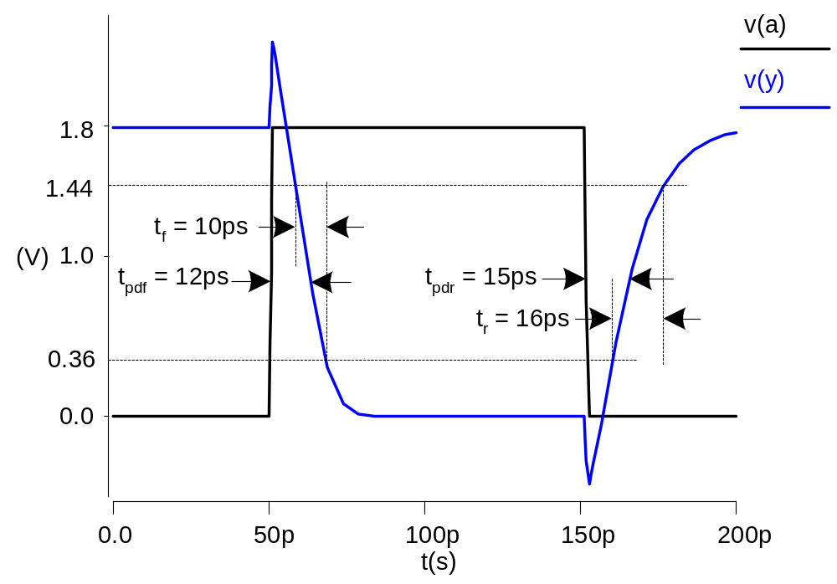
Transient Results
Unloaded inverter
  Overshoot
  Very fast
  edges

Slide 16
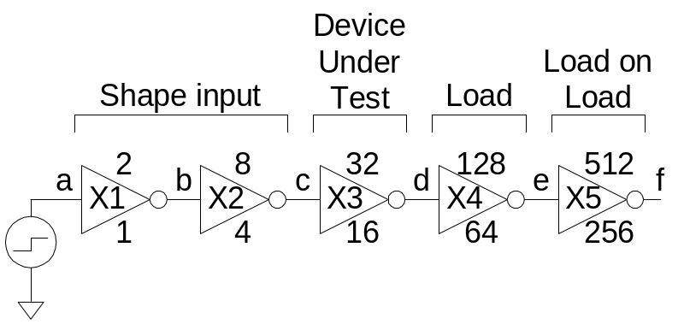
Subcircuits
Declare common elements as subcircuits
Ex: Fanout-of-4 Inverter Delay
  Reuse inv
  Shaping
  Loading
.subckt inv a y N=4 P=8
M1 y a gnd gnd NMOS W='N' L=2
+ AS='N*5' PS='2*N+10' AD='N*5' PD='2*N+10'
M2 y a vdd vdd PMOS W='P' L=2
+ AS='P*5' PS='2*P+10' AD='P*5' PD='2*P+10'
.ends

Slide 17
FO4 Inverter Delay
* fo4.sp
* Parameters and models
*----------------------------------------------------------------------
.param SUPPLY=1.8
.param H=4
.option scale=90n
.include '../models/tsmc180/models.sp'
.temp 70
.option post
* Subcircuits
*----------------------------------------------------------------------
.global vdd gnd
.include '../lib/inv.sp'
* Simulation netlist
*----------------------------------------------------------------------
Vdd vdd gnd 'SUPPLY'
Vin a gnd PULSE 0 'SUPPLY' 0ps 100ps 100ps 500ps 1000ps
X1 a b inv * shape input waveform
X2 b c inv M='H' * reshape input waveform
.end

Slide 18
FO4 Inverter Delay (cont’d.)
X3 c d inv M='H**2' * device under test
X4 d e inv M='H**3' * load
x5 e f inv M='H**4' * load on load
* Stimulus
*----------------------------------------------------------------------
.tran 1ps 1000ps
.measure tpdr * rising prop delay
+ TRIG v(c) VAL='SUPPLY/2' FALL=1
+ TARG v(d) VAL='SUPPLY/2' RISE=1
.measure tpdf * falling prop delay
+ TRIG v(c) VAL='SUPPLY/2' RISE=1
+ TARG v(d) VAL='SUPPLY/2' FALL=1
.measure tpd param='(tpdr+tpdf)/2' * average prop delay
.measure trise * rise time
+ TRIG v(d) VAL='0.2*SUPPLY' RISE=1
+ TARG v(d) VAL='0.8*SUPPLY' RISE=1
.measure tfall * fall time
+ TRIG v(d) VAL='0.8*SUPPLY' FALL=1
+ TARG v(d) VAL='0.2*SUPPLY' FALL=1
.end

Slide 19
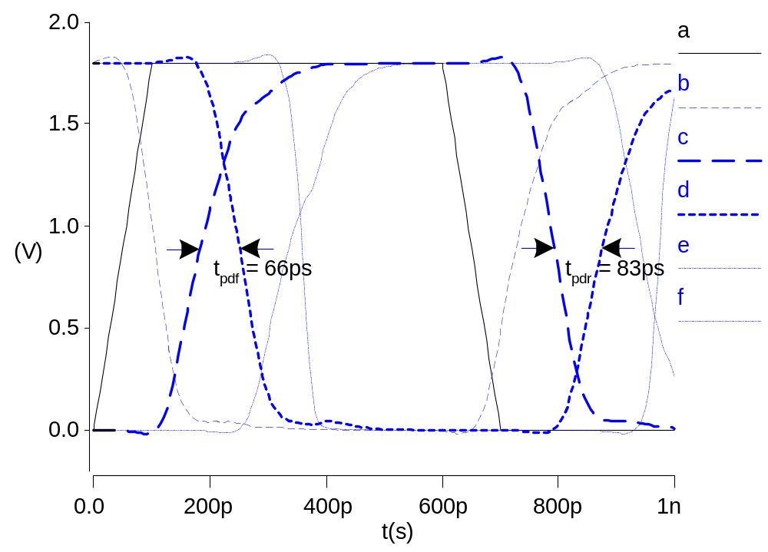
FO4 Results

Slide 20
Optimization
HSPICE can automatically adjust parameters
  Seek value that optimizes some measurement
Example: Best P/N ratio
  We’ve assumed 2:1 gives equal rise/fall delays
  But we see rise is actually slower than fall
  What P/N ratio gives equal delays?
Strategies
  (1) run a bunch of sims with different P size
  (2) let HSPICE optimizer do it for us

Slide 21
p/n Optimization
* fo4opt.sp
* Parameters and models
*----------------------------------------------------------------------
.param SUPPLY=1.8
.option scale=90n
.include '../models/tsmc180/models.sp'
.temp 70
.option post
* Subcircuits
*----------------------------------------------------------------------
.global vdd gnd
.include '../lib/inv.sp'
* Simulation netlist
*----------------------------------------------------------------------
Vdd vdd gnd 'SUPPLY'
Vin a gnd PULSE 0 'SUPPLY' 0ps 100ps 100ps 500ps 1000ps
X1 a b inv P='P1' * shape input waveform
X2 b c inv P='P1' M=4 * reshape input
X3 c d inv P='P1' M=16 * device under test

Slide 22
p/n Optimization
X4 d e inv P='P1' M=64 * load
X5 e f inv P='P1' M=256 * load on load
* Optimization setup
*----------------------------------------------------------------------
.param P1=optrange(8,4,16) * search from 4 to 16, guess 8
.model optmod opt itropt=30 * maximum of 30 iterations
.measure bestratio param='P1/4' * compute best P/N ratio
* Stimulus
*----------------------------------------------------------------------
.tran 1ps 1000ps SWEEP OPTIMIZE=optrange RESULTS=diff MODEL=optmod
.measure tpdr * rising propagation delay
+ TRIG v(c) VAL='SUPPLY/2' FALL=1
+ TARG v(d) VAL='SUPPLY/2' RISE=1
.measure tpdf * falling propagation delay
+ TRIG v(c) VAL='SUPPLY/2' RISE=1
+ TARG v(d) VAL='SUPPLY/2' FALL=1
.measure tpd param='(tpdr+tpdf)/2' goal=0 * average prop delay
.measure diff param='tpdr-tpdf' goal = 0 * diff between delays
.end

Slide 23
p/n Results
p/n ratio for equal delay is 3.6:1
  t_{pd} = t_{pdr} = t_{pdf} = 84 ps (slower than 2:1 ratio)
  Big pMOS transistors waste power too
  Seldom design for exactly equal delays
What ratio gives lowest average delay?
  .tran 1ps 1000ps SWEEP OPTIMIZE=optrange RESULTS=tpd MODEL=optmod
  p/n ratio of 1.4:1
  t_{pdr} = 87 ps, t_{pdf} = 59 ps, t_{pd} = 73 ps

Slide 24
Power Measurement
HSPICE can measure power
  Instantaneous P(t)
  Or average P over some interval
  .print P(vdd)
  .measure pwr AVG P(vdd) FROM=0ns TO=10ns
Power in single gate
  Connect to separate V_{DD} supply
  Be careful about input power

Slide 25
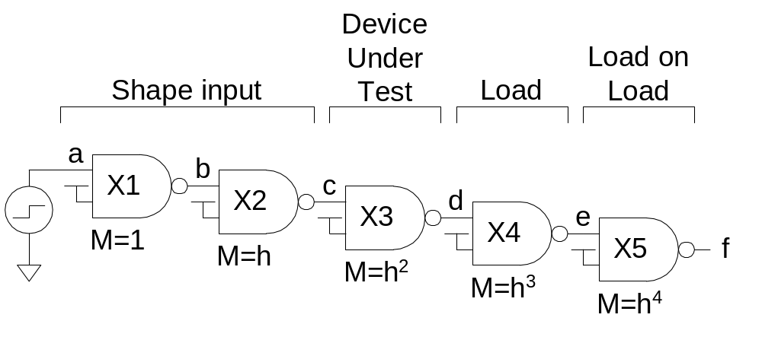
Logical Effort
Logical effort can be measured from simulation
  As with FO4 inverter, shape input, load output

Slide 26
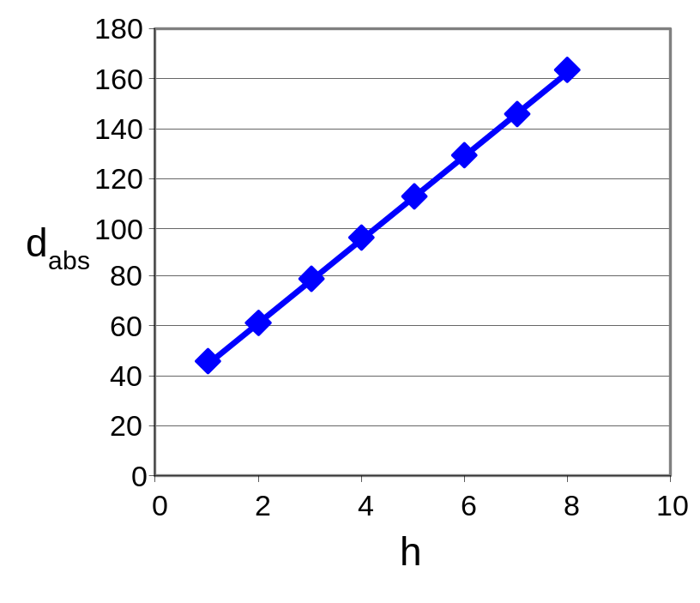
Logical Effort Plots
Plot t_{pd} vs. h
  Normalize by τ
  y-intercept is parasitic delay
  Slope is logical effort
Delay fits straight line
very well in any process
as long as input slope is
consistent
τ = 15 ps

Slide 27
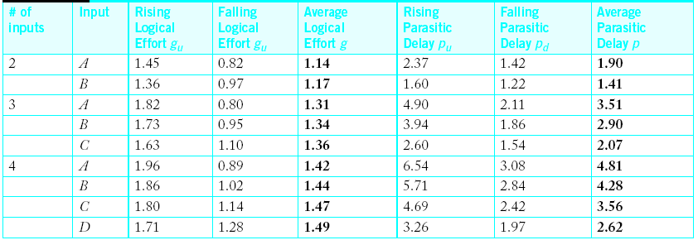
Logical Effort Data
For NAND gates in TSMC 180 nm process:
Notes:
  Parasitic delay is greater for outer input
  Average logical effort is better than estimated

Slide 28
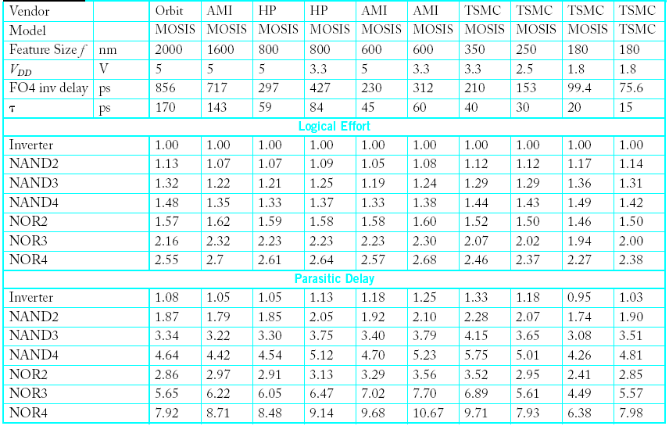
Comparison

Slide 29
Summary
Introduction to SPICE
DC Analysis
Transient Analysis
Subcircuits
Optimization
Power Measurement
Logical Effort Characterization

